Slide 1
Obesity classification with autoai
Presented By:
1. Student Name-Pratyasha Dutta
2. College Name- St Thomas' College of Engineering & Technology
Department- Computer Science and Engineering

Slide 2
OUTLINE
Problem Statement (Should not include solution)
Proposed System/Solution
System Development Approach (Technology Used)
Algorithm & Deployment
Result
Conclusion
Future Scope
References

Slide 3
Problem Statement
Obesity classification is a method of categorizing individuals based on their body mass index (BMI) and other health factors. It typically includes categories like underweight, normal weight, overweight, and various classes of obesity. This classification helps healthcare professionals assess health risks, plan interventions, and track population health trends. It's a crucial tool in addressing the global obesity epidemic.

Slide 4
Proposed Solution
Here's a proposed solution for an obesity classification where the task is to label the person(underweight, obese or normal weight) based on some criteria:
1. Data Preparation: - Collect and clean your obesity dataset.
- Upload the dataset to IBM Cloud Storage.
2. AutoAI Setup: - Create a new AutoAI experiment in IBM Watson Studio.
- Select the uploaded dataset as the source.
- Choose the target variable (obesity classification).
3. AutoAI Configuration: - Set the problem type to multiclass classification.
- Select relevant features for the model.
- Configure experiment settings (e.g., runtime, optimization metric).
4. Run AutoAI: - Start the AutoAI process to automatically: - Preprocess data
- Select algorithms
- Perform feature engineering
- Optimize hyperparameters

Slide 5
Proposed Solution
5. Model Comparison: - Review generated model pipelines.
- Compare performance metrics across models.
6. Model Selection: - Choose the best-performing model based on metrics like accuracy, F1-score.
7. Model Deployment: - Deploy the selected model as a web service on IBM Cloud.
8. Integration: - Use the deployed model's API in your application or healthcare system.
9. Monitoring: - Set up performance monitoring for the deployed model.
This approach leverages AutoAI's capabilities to automate much of the machine learning pipeline, potentially saving time and resources in model development.

Slide 6
SYSTEM APPROACH
The "System Approach" section outlines the overall strategy and methodology for developing and implementing the Obesity classification and label system. Here's a suggested structure for this section:
System requirements:- IBM Cloud Account: Active subscription with appropriate permissions.
Compute Resources: Sufficient CPU and GPU capacity for AutoAI processing and Minimum 16GB RAM recommended.
Storage: IBM Cloud Object Storage for dataset and model storage and Adequate capacity for data and model versions.
IBM Watson Studio: Access to Watson Studio on IBM Cloud and AutoAI capability enabled.
Library requirements :- For an obesity classification problem using IBM Cloud AutoAI, you typically don't need to manage libraries directly, as AutoAI handles most of the machine learning pipeline automatically. However, here are some key libraries and components that are usually involved in the background:
IBM Watson Machine Learning: Core library for machine learning operations on IBM Cloud.
IBM Cloud SDK: For interacting with IBM Cloud services.
JSON: For data interchange in API calls.
IBM Watson Studio Runtime: Includes many pre-installed data science libraries.

Slide 7
ALGORITHM & DEPLOYMENT
In the Algorithm section, describe the machine learning algorithm chosen for predicting weight labels. Here's an example structure for this section:​
The algorithm selection and deployment process is largely automated. ​
Here's an overview: ​
Algorithms: AutoAI typically tests and optimizes several algorithms, including: ​
1. Logistic Regression 2. Decision Trees 3. Random Forest 4. Gradient Boosting Machines (e.g., XGBoost) ​
5. Support Vector Machines 6. Neural Networks (if applicable) ​
The system automatically selects and tunes the best-performing algorithm based on your data and specified evaluation metrics.​
Deployment: 1. Model Selection: - AutoAI generates multiple model pipelines
- You review and select the best model based on performance metrics ​
2. Deployment Options: - Web Service: Deploy as a REST API - Batch Deployment: For processing large datasets​
- Real-time Deployment: For immediate predictions ​
3. Deployment Steps: - Choose deployment type in Watson Studio - Configure deployment settings (e.g., compute resources, scaling) ​ - Deploy model with a single click - Obtain API endpoint and credentials ​
4. Integration: - Use the provided API to integrate the model into your applications - Test the deployed model with sample data ​
5. Monitoring: - Set up performance monitoring in IBM Cloud - Track model accuracy and usage metrics ​
6. Maintenance: - Schedule regular model evaluations - Retrain or update the model as needed using AutoAI.​
This approach combines sophisticated algorithm selection with streamlined deployment, making it efficient for rapid development and implementation of obesity classification models.​

Slide 8
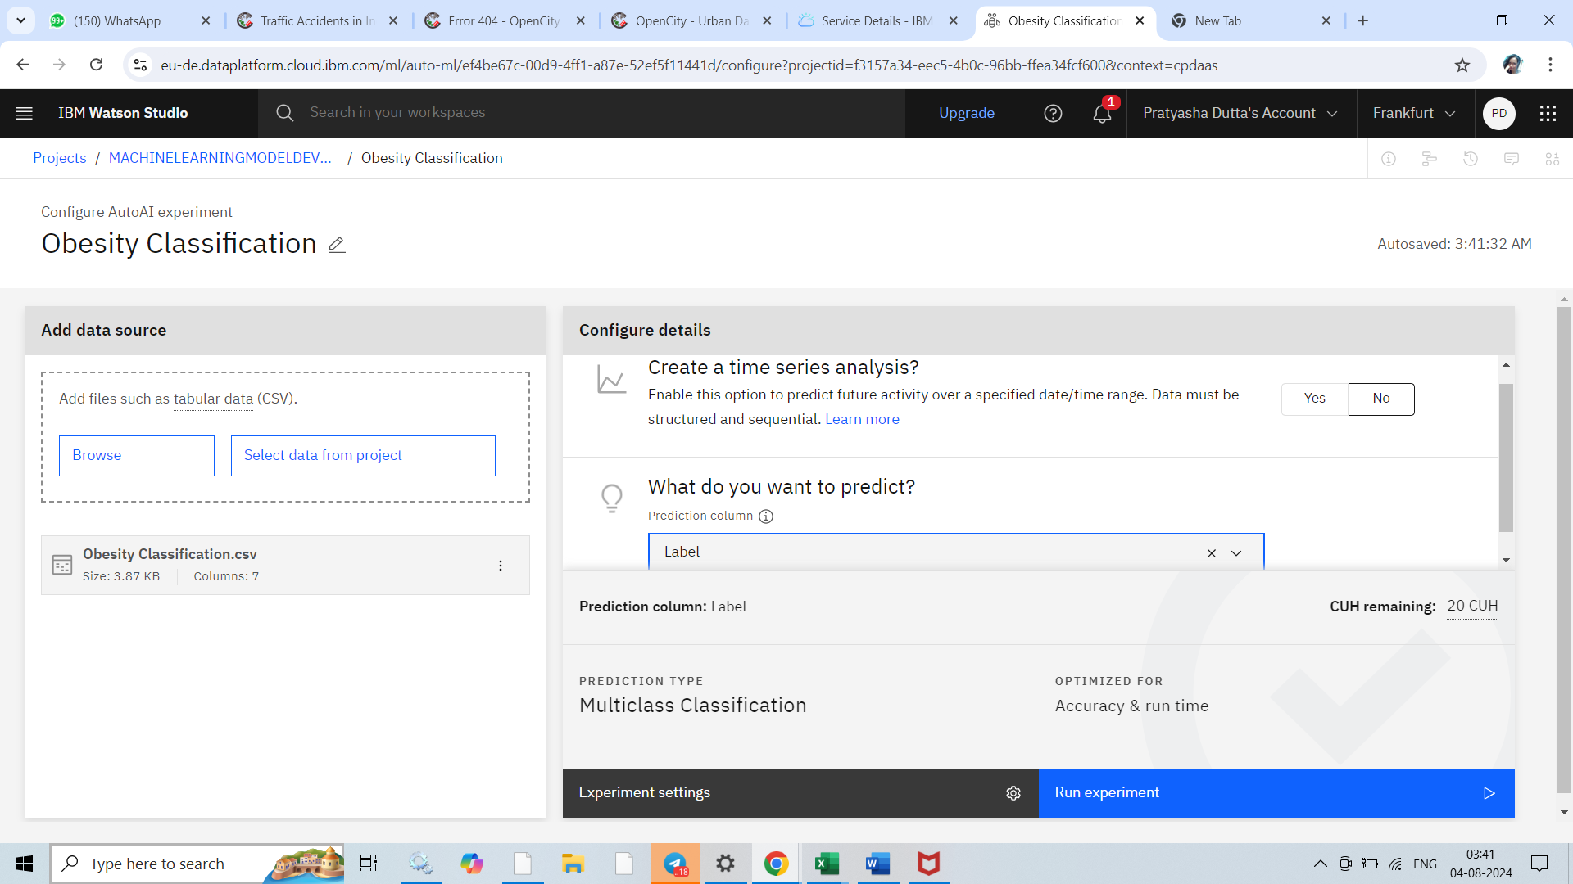
RESULT

Slide 9
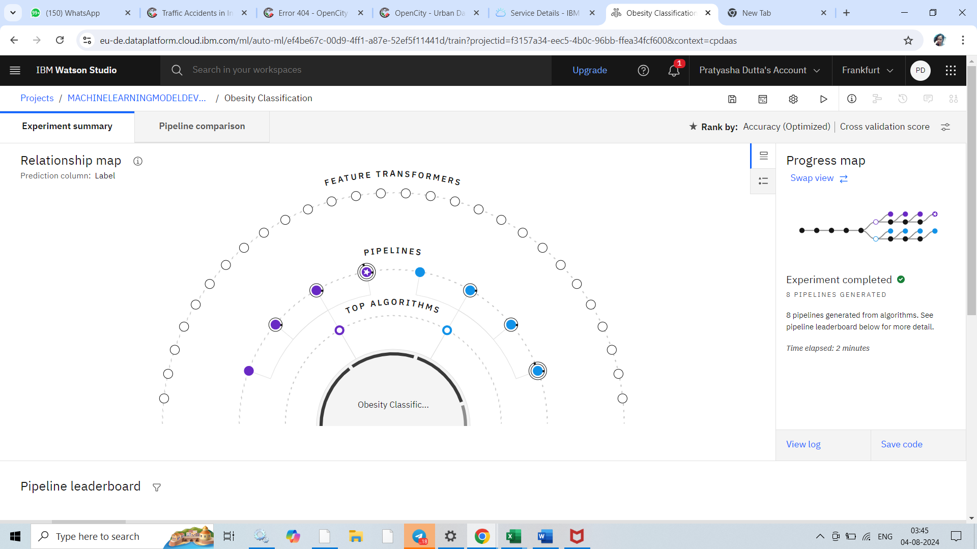

Slide 10
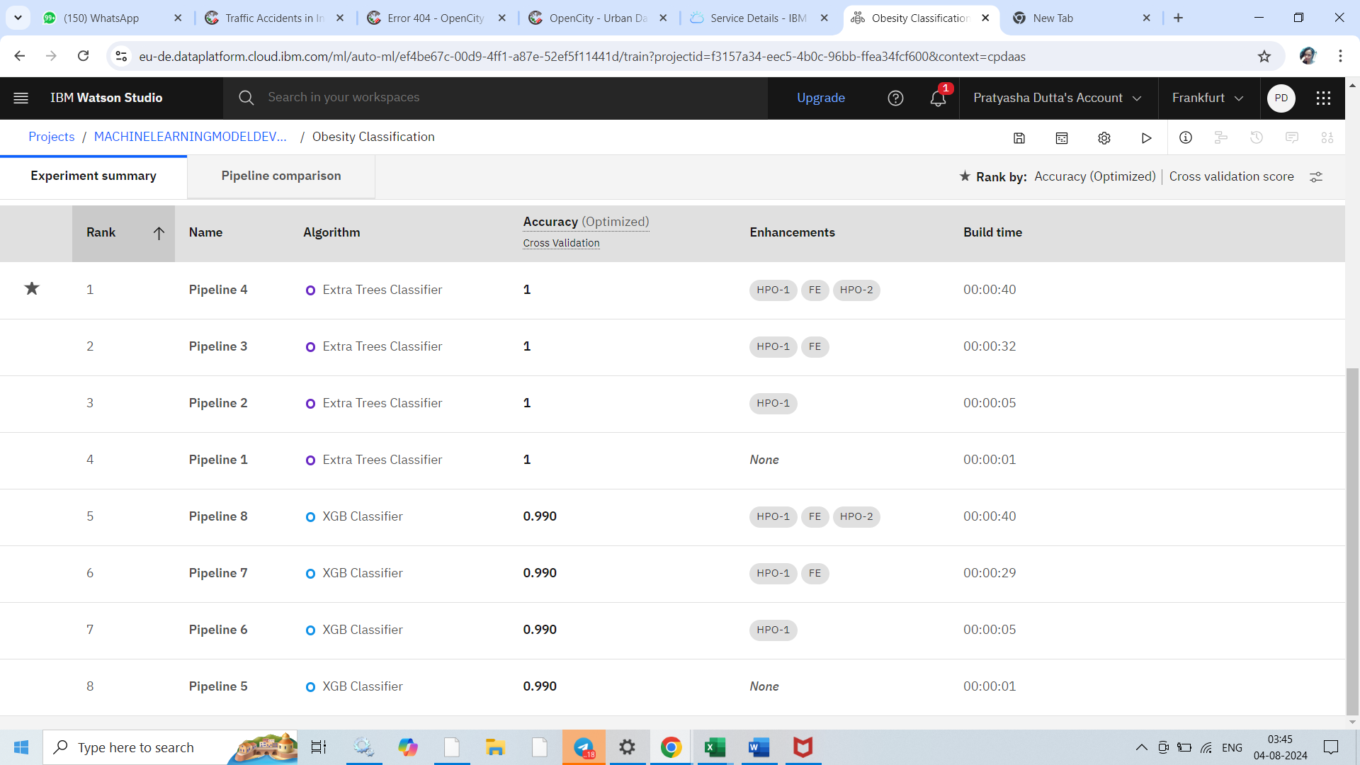

Slide 11
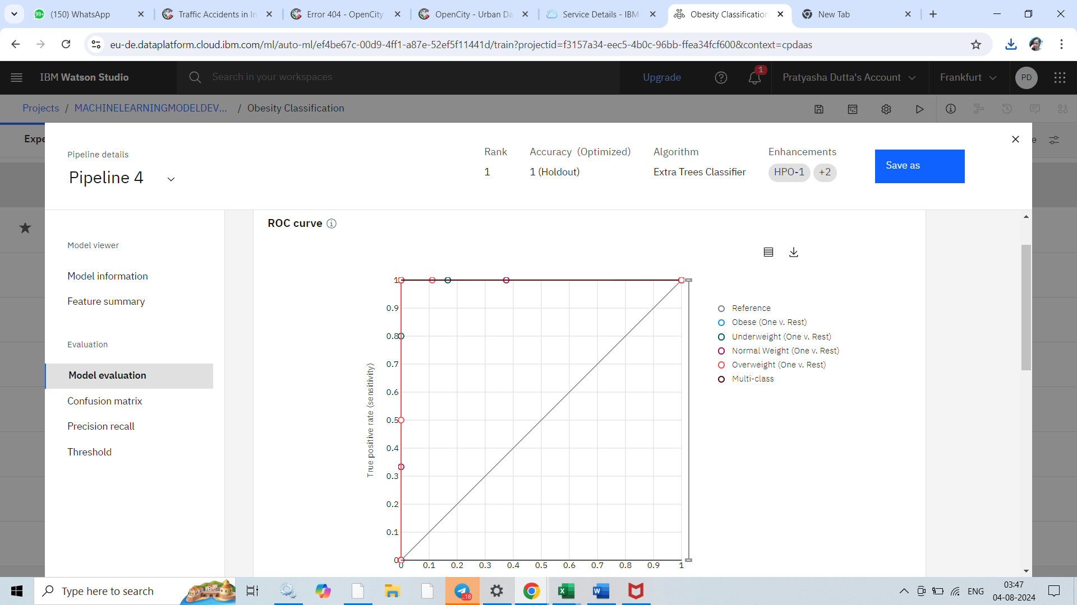
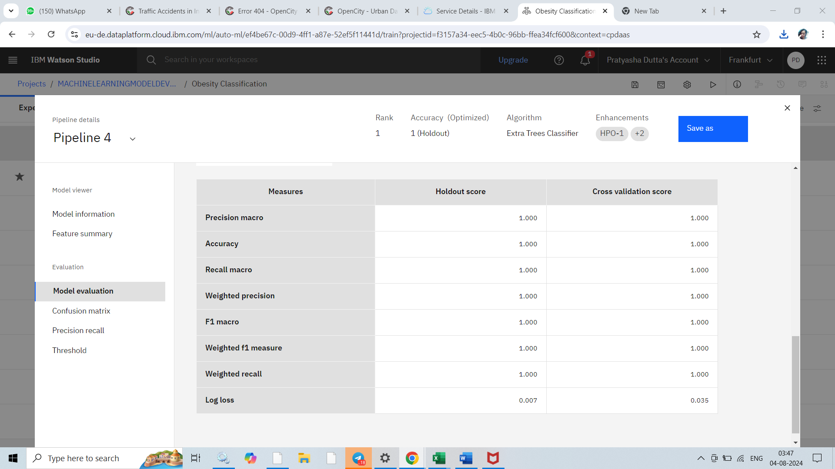
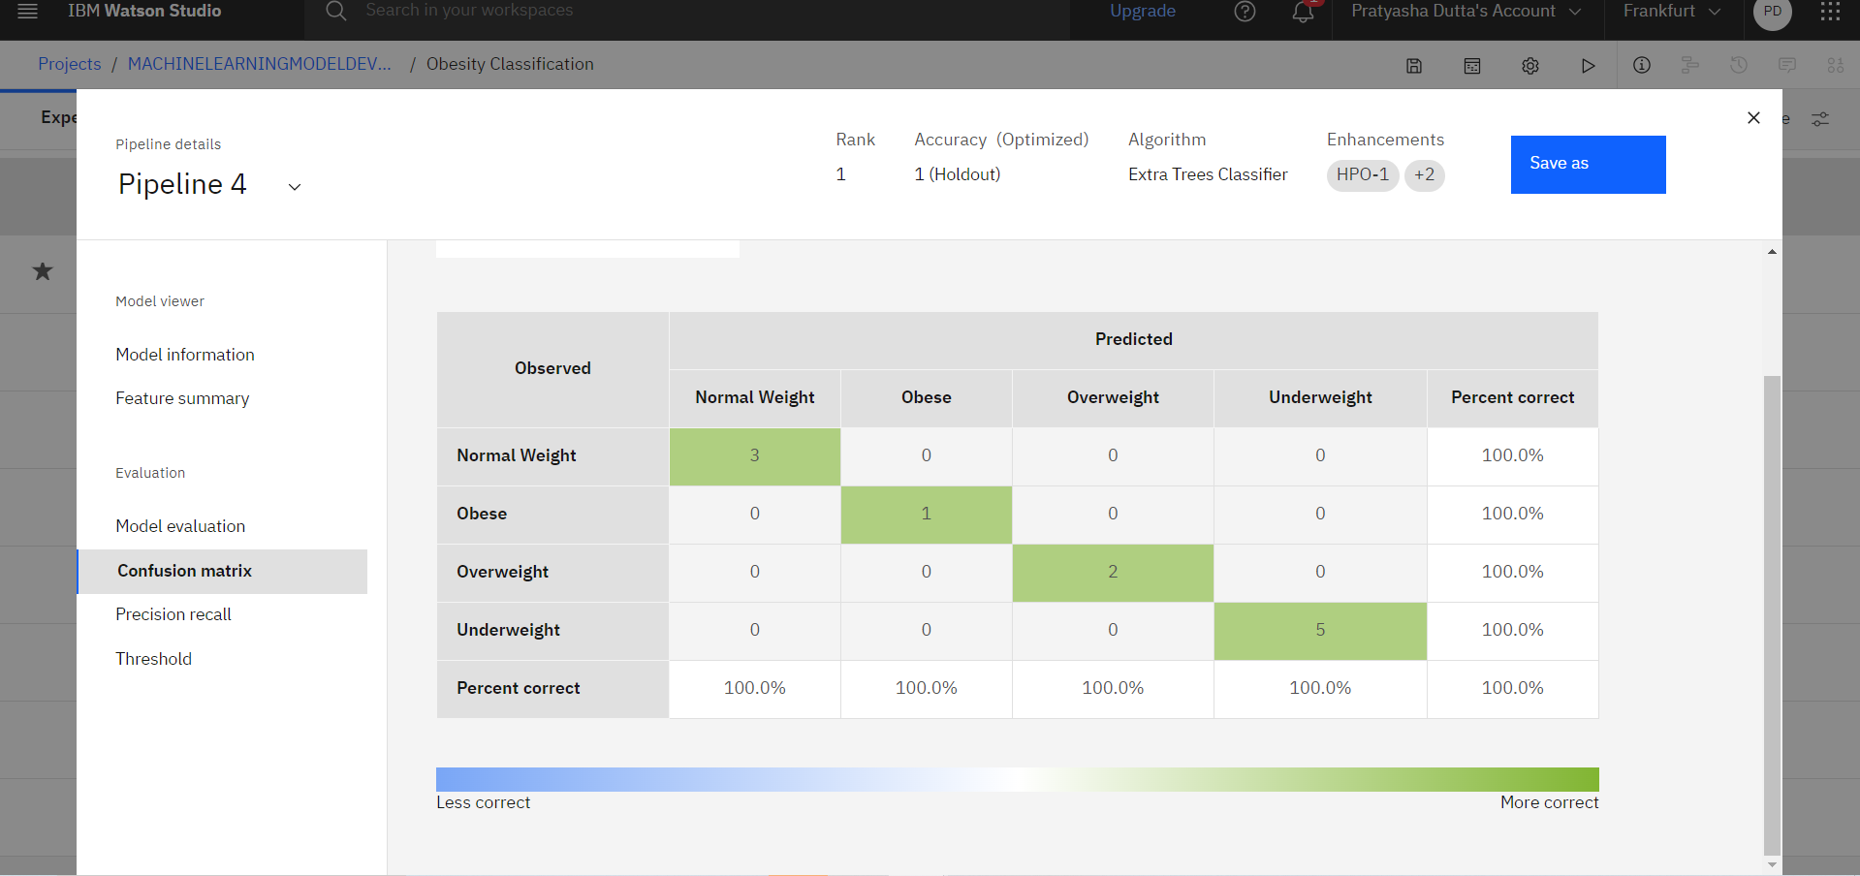
PIPELINE 4: BEST RATED

Slide 12
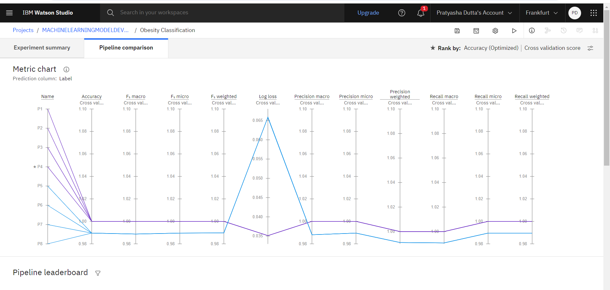

Slide 13
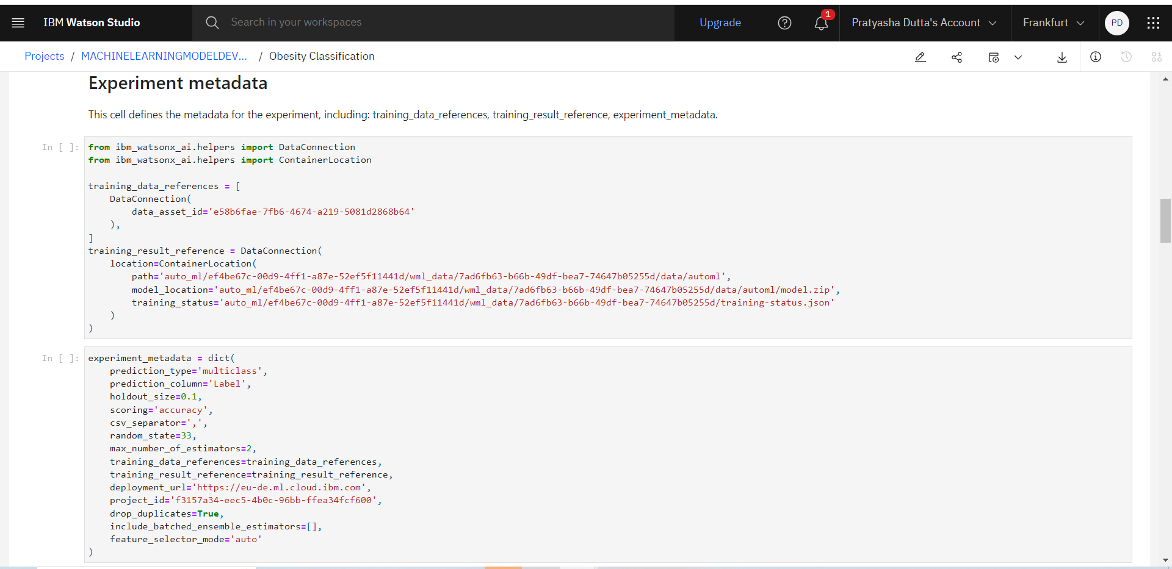

Slide 14
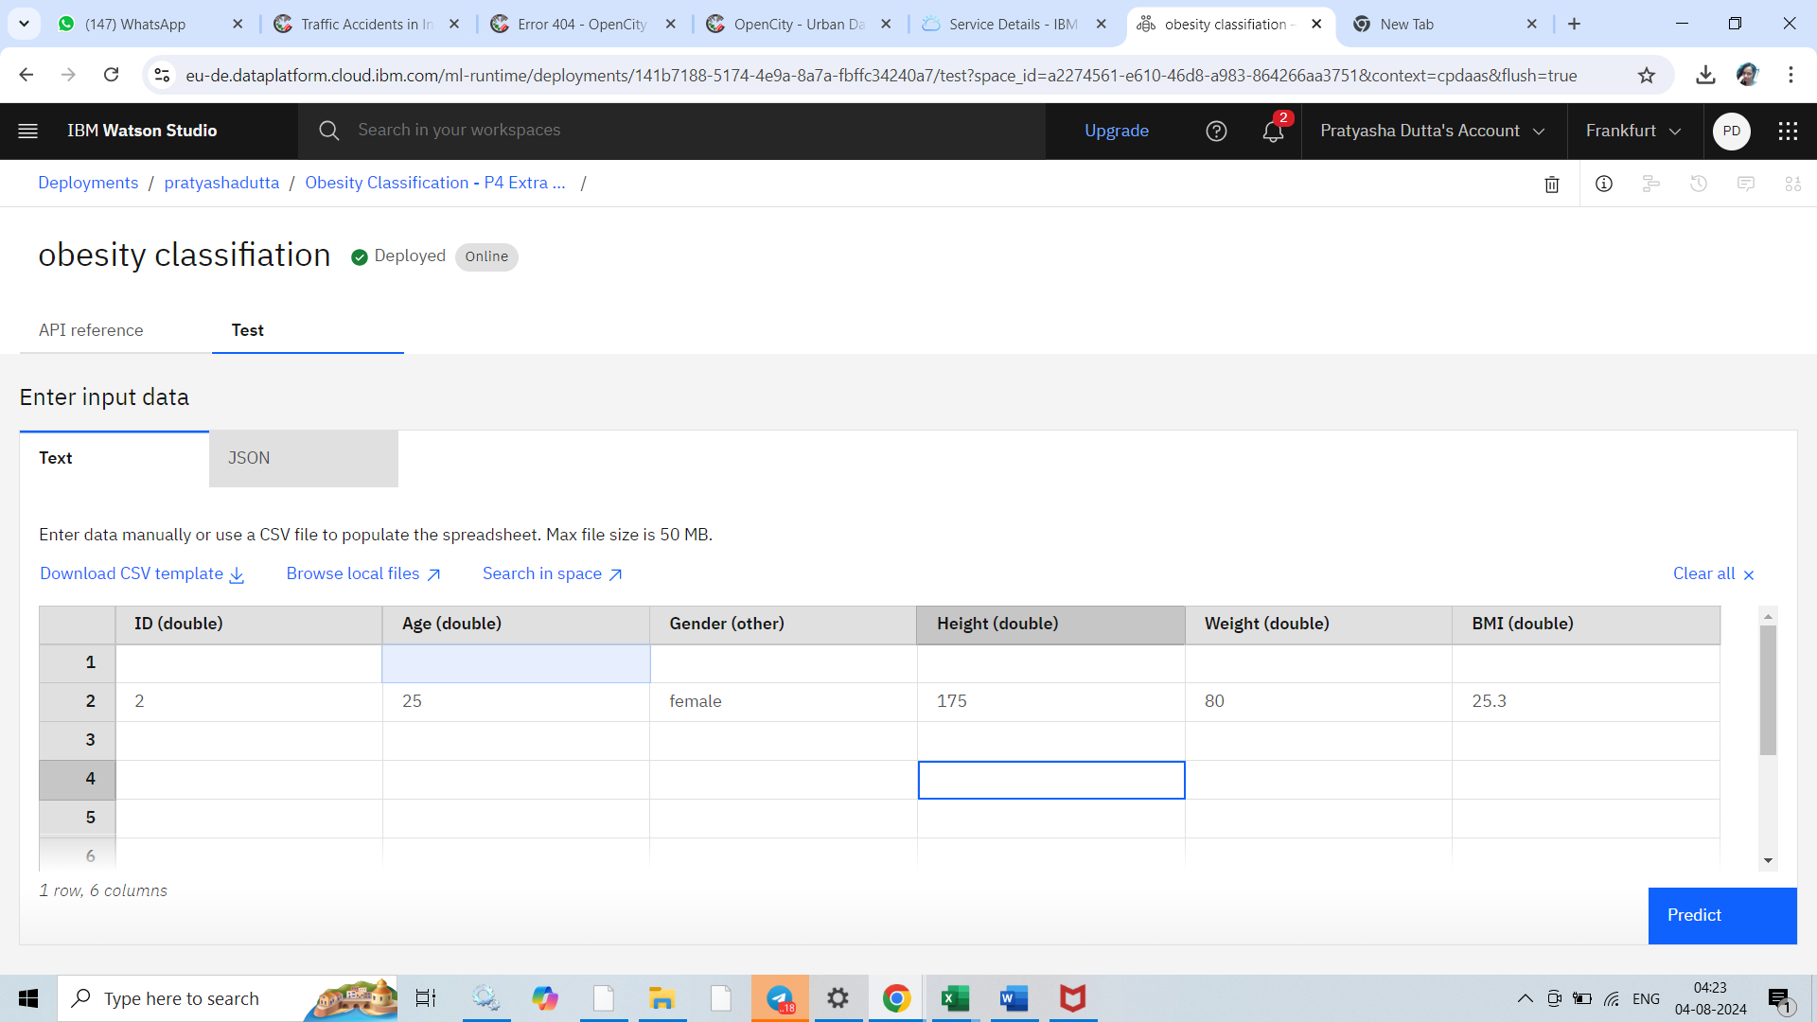
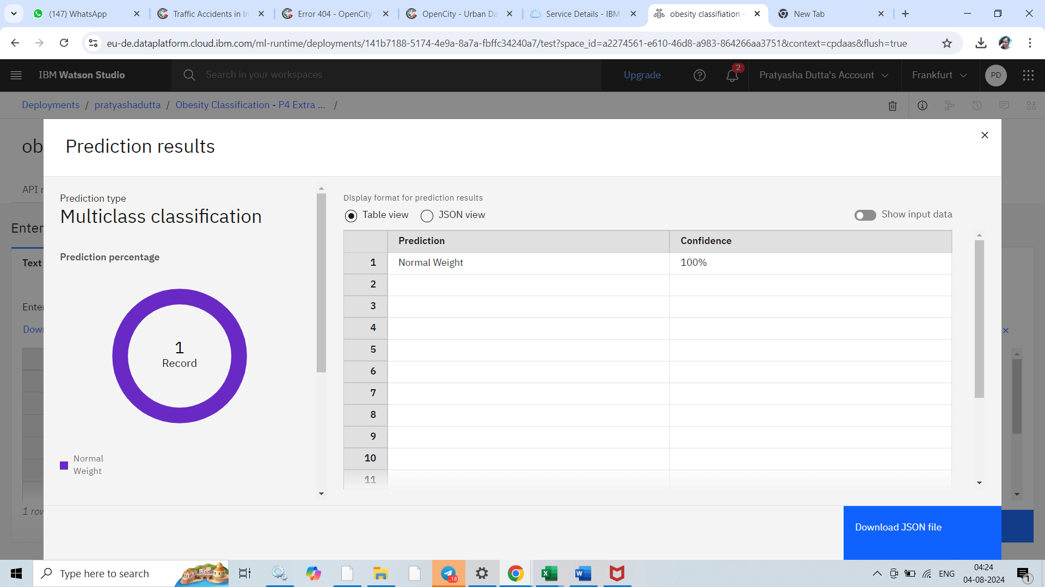
TEST OF THE MODEL

Slide 15
CONCLUSION
The IBM Cloud AutoAI approach to obesity classification offers an efficient, automated solution to a complex health problem. It leverages advanced machine learning techniques without requiring deep expertise in data science.
Key benefits:
1. Automated model selection and optimization.
2. Reduced development time and resources.
3. Scalable cloud-based deployment.
4. Integration-ready API for healthcare systems.
Limitations:
1. Less control over specific model parameters.
2. Potential for overfitting if not carefully monitored.
3. Dependence on IBM Cloud infrastructure.
Overall, this approach provides a powerful tool for healthcare professionals to quickly develop and deploy obesity classification models. It balances ease of use with sophisticated analytics, potentially improving early diagnosis and intervention strategies in obesity management. The success of such a system ultimately depends on the quality of input data, proper interpretation of results, and integration into broader healthcare practices.

Slide 16
Future scope
The future scope of obesity classification is poised for significant advancements, driven by technological innovations and interdisciplinary approaches. Personalized medicine will likely take center stage, integrating genetic and microbiome data to provide tailored risk assessments and interventions. Wearable technologies and smart devices will enable continuous monitoring of relevant health parameters, offering real-time data for more accurate classifications.
Artificial intelligence and machine learning will play a crucial role, with sophisticated deep learning models capable of recognizing complex patterns in diverse datasets. These models will incorporate a wide range of factors, including environmental and socioeconomic data, for more comprehensive assessments. Predictive analytics will evolve to forecast obesity trends at both individual and population levels, enabling proactive interventions. Automated systems may provide personalized lifestyle recommendations based on real-time data analysis. Ethical considerations will become increasingly important, with a focus on developing unbiased models and ensuring equitable application across diverse populations. Explainable AI will improve model interpretability for healthcare professionals and patients alike. Global health initiatives will benefit from adaptive models that account for cultural and geographical differences. Interdisciplinary collaboration will intensify, combining insights from medical, behavioral, and data sciences to create holistic solutions for obesity management and prevention.

Slide 17
REFERENCES
I took help from ChatGpt and other websites like wikipedia.com
Notebook link of my project
https://eu-de.dataplatform.cloud.ibm.com/analytics/notebooks/v2/d8984a05-d089-4d03-928a-c83cc312d646/view?access_token=3c72dd1d734893b5d84316bb6078d6356c00541c2954284fdc32f1834d84abdb&context=cpdaas
API link of my model
https://private.eu-de.ml.cloud.ibm.com/ml/v4/deployments/141b7188-5174-4e9a-8a7a-fbffc34240a7/predictions?version=2021-05-01
(private)
https://eu-de.ml.cloud.ibm.com/ml/v4/deployments/141b7188-5174-4e9a-8a7a-fbffc34240a7/predictions?version=2021-05-01
(public)

Slide 18
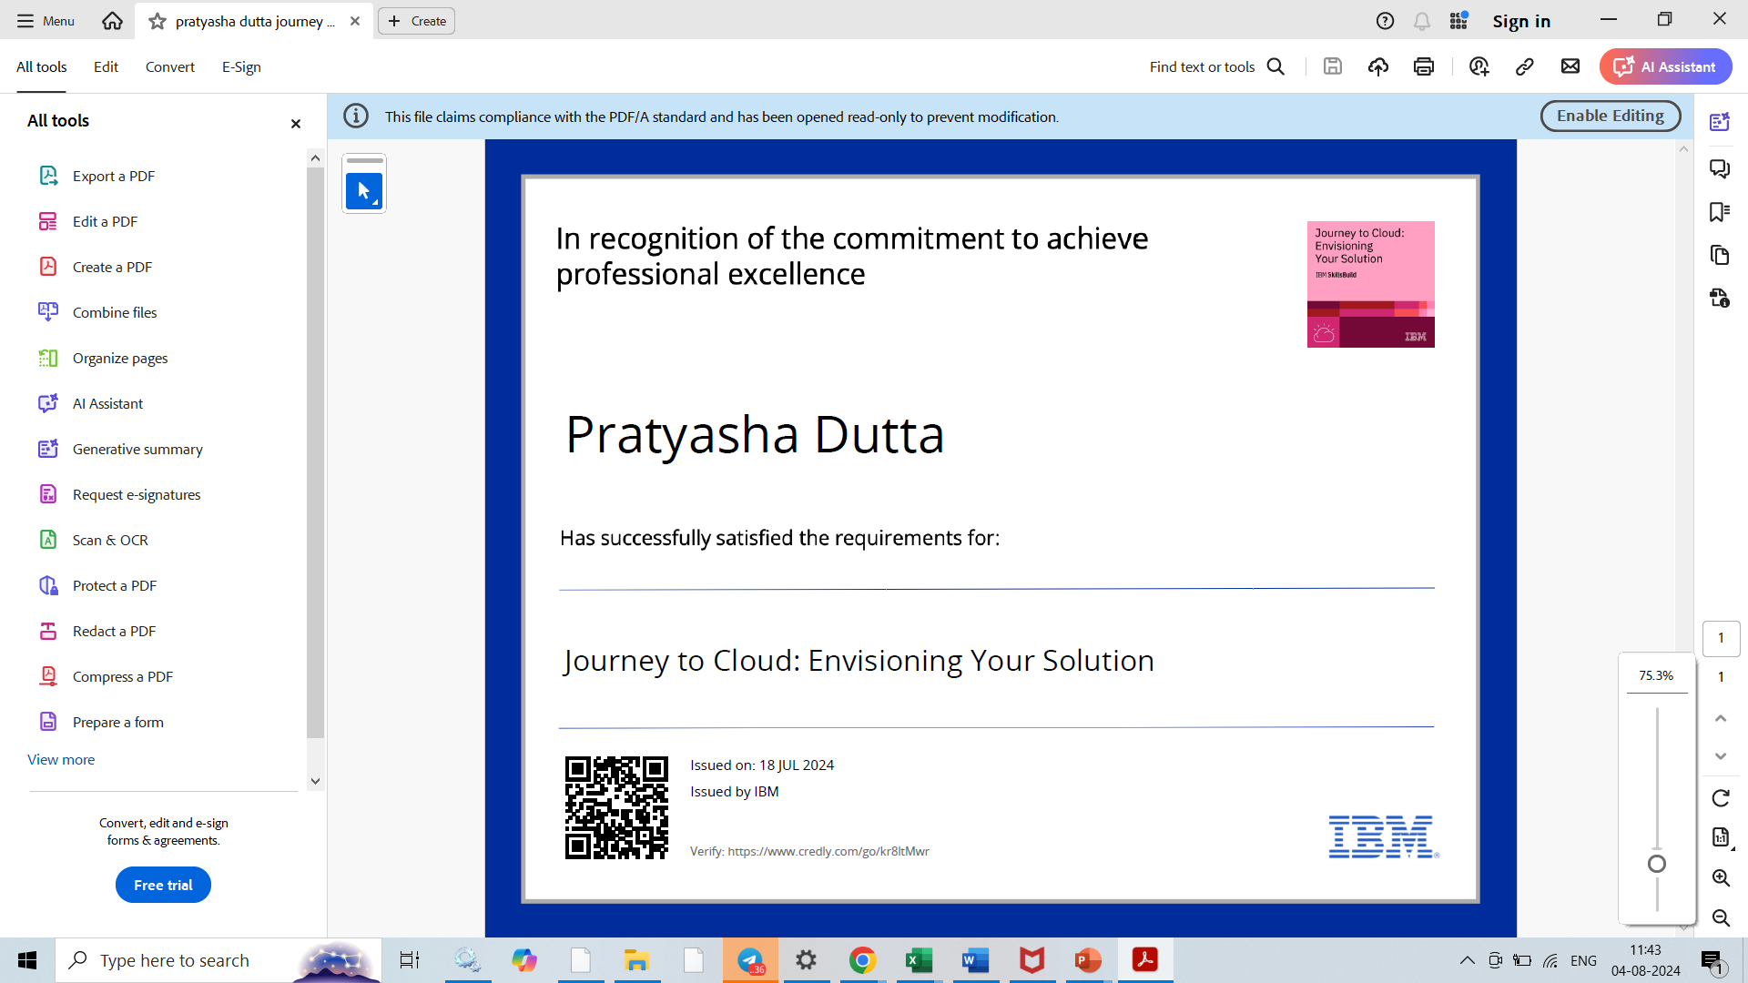
course certificate 1

Slide 19
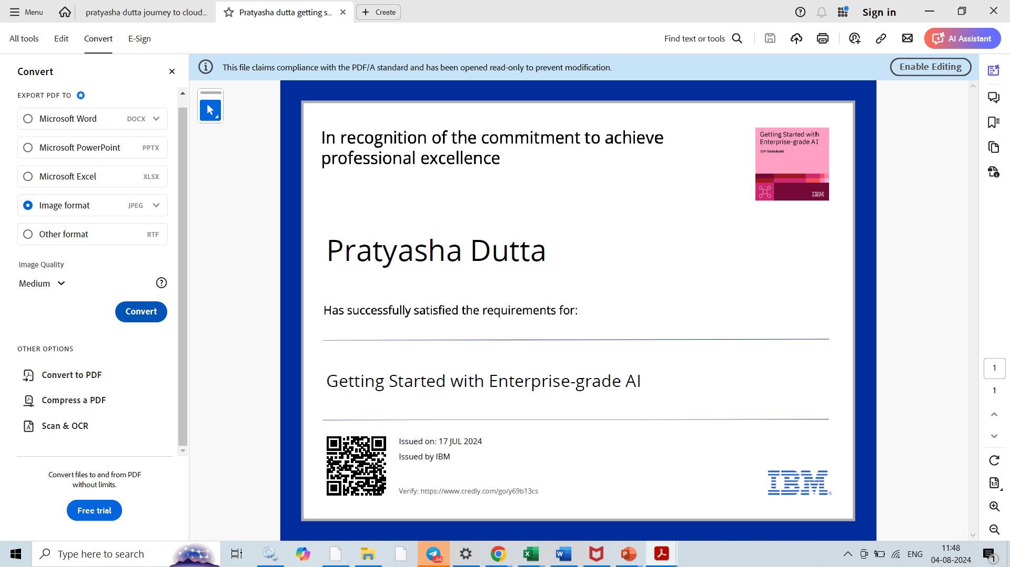
course certificate 2

Slide 20
THANK YOU

